Slide 1
Blackboard Ally
Making Websites Accessible

Slide 2
Ally Accessibility report
Helps track progress and can help highlight problem areas and identify initiatives that can further help improve accessibility on the site.
Obtain access by contacting ITAccessibility@uconn.edu
Sign in with Microsoft using UConn email address at: https://prod.ally.ac/launch/7085

Slide 3
DOMAIN REPORTS
See how content on your site is performing by domain.
For each domain, you see the name, the number of items in the domain with an issue, the base URL, and the accessibility score for the domain.
You can search for a specific domain, export the domains report or select a domain for more details

Slide 4
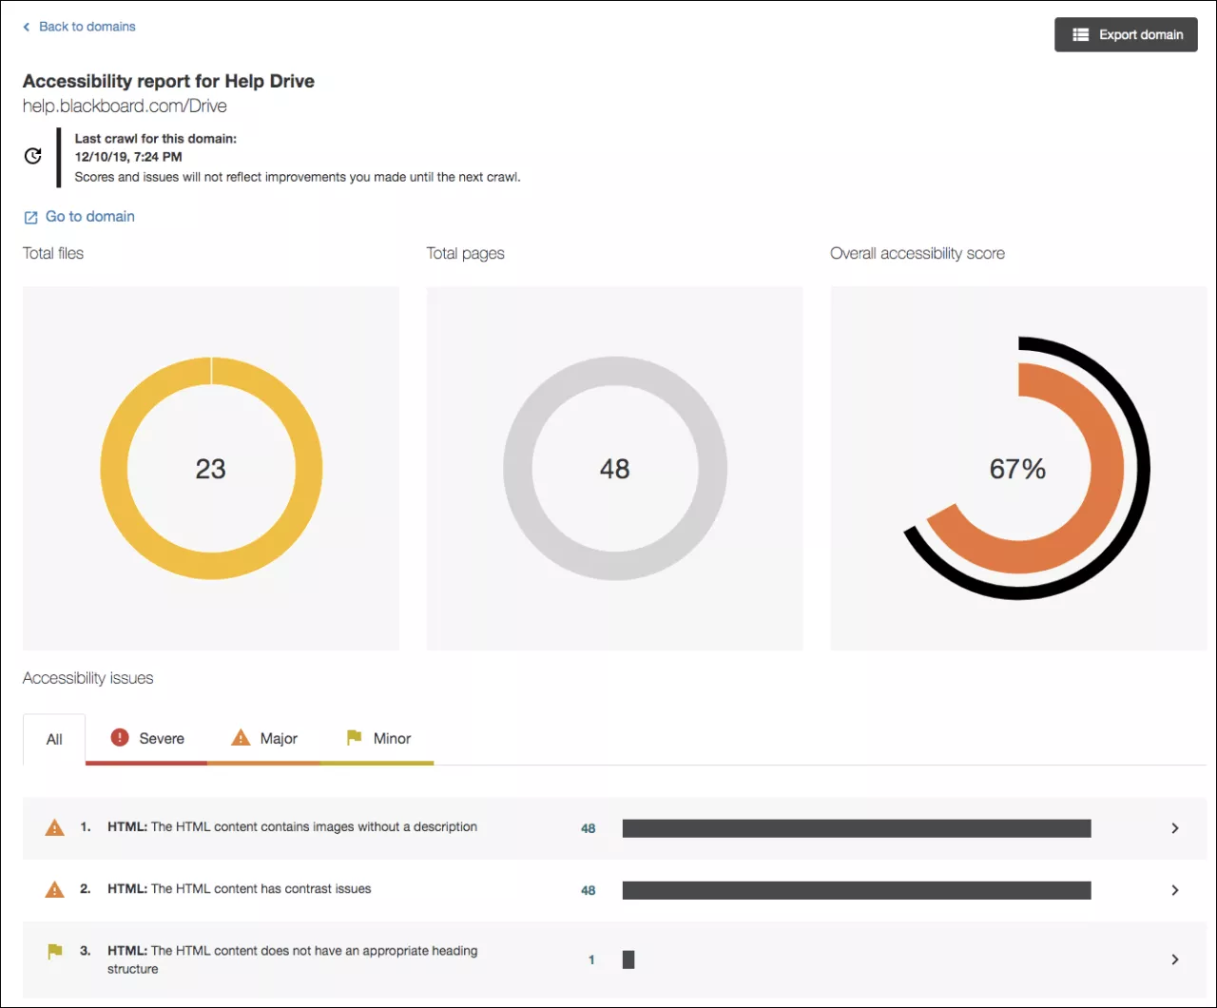
Individual DOMAIN REPORTS
You can see the total files, the total web pages, the overall accessibility score, and accessibility issues in the domain.
Select Export domain to download the individual domain report.
Select an item to see the web page or file.
Select Go to domain to visit the domain outside of Ally.

Slide 5
Accessibility issues
Issues are listed by frequency.
Select Severe, Major, or Minor to filter the issues by severity.
At-a-glance you can determine basic information for each issue.
Content type
Accessibility issue
Severity
Total number of items with the issue

Slide 6
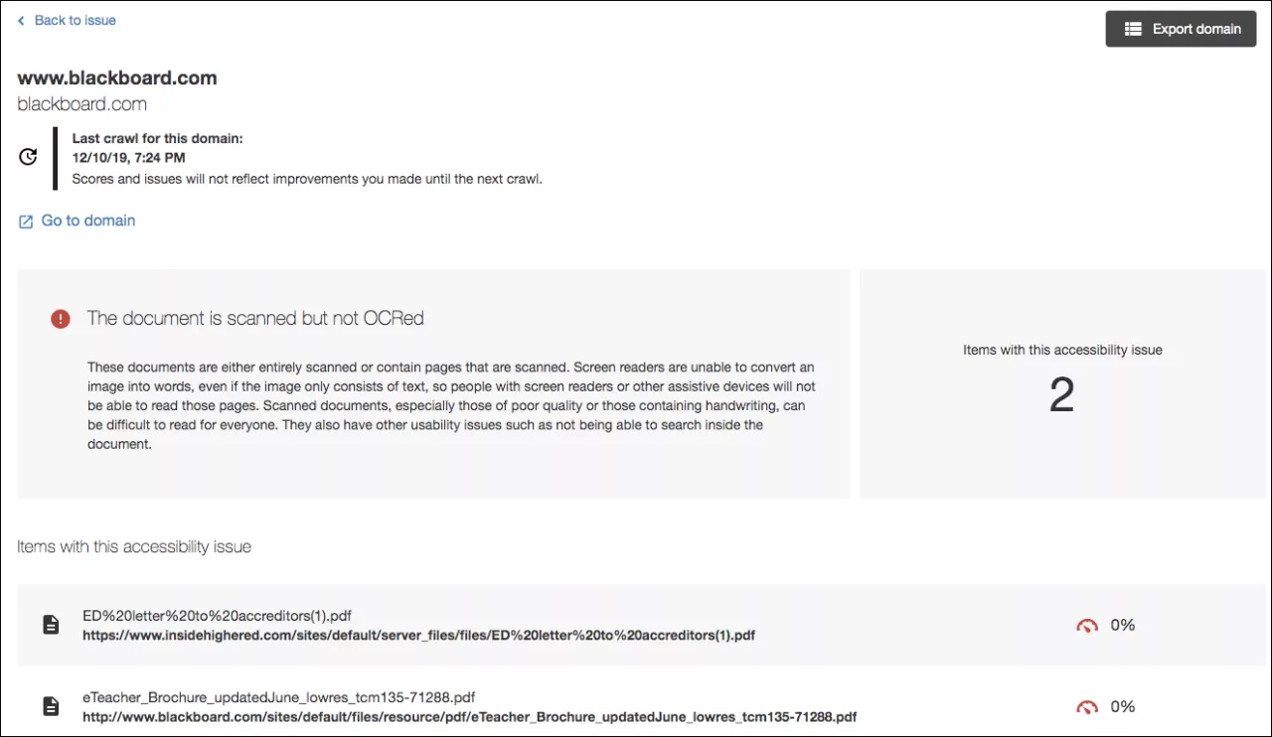
Accessibility issues in detail
Select an issue to see a full description of the issue and the items impacted. See each item and its accessibility score.

Slide 7
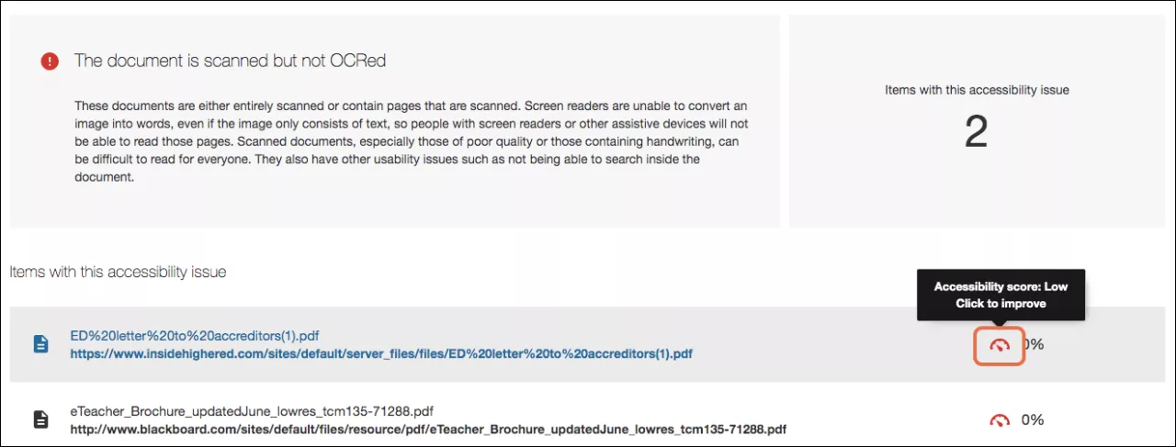
Improve an item’s accessibility
Find a specific content item in a domain with an accessibility issue. Select the content item's accessibility score indicator to open the feedback panel.

Slide 8
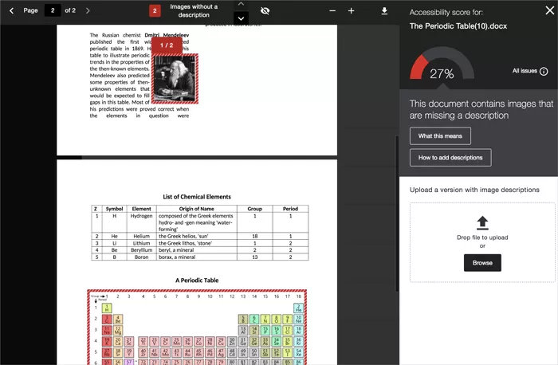
Open feedback panel
Ally produces an accessibility score for each file.
Select the Accessibility score to open the feedback panel.
Ally’s feedback panel shows you a preview of the document’s content as well as detailed feedback and support to help you fix your accessibility issues.

Slide 9
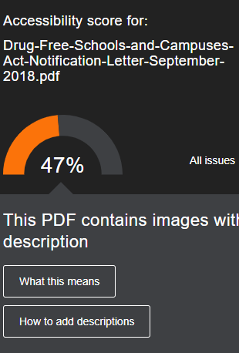
Simple Guidance
Provide guidance on how to fix accessibility issues and generate a change in behavior over time and at the point-of-need.
Step-by-step instructions are offered and when it’s a PDF, it always begin with, “Can you get hold of an original, editable version of this file?”

Slide 10
Export ally accessibility report
You can export Ally CSV reports by year, by month, by domains, and for individual domains.
For individual domains: rows are content items and columns are general information, scores, and accessibility issues.
Most frequently used columns:
Mime Type: webpage, pdf, word, ppt, image
Score: accessibility score of that item
Deleted at: filter on blank items (Ally keeps history of content that is deleted so you don’t need to see these rows)
URL: link to the file (pdf, word, ppt, image)
Remaining columns to right of Checked On list the issues found with the webpage or file

Slide 11
Alternative Formats
Advanced machine learning algorithms automatically provides users with access to various formats.
Found on each UConn website scanned by Ally by clicking the icon below.

Slide 12
Tagged pdf
Structured PDF for improved use with assistive technology.
Only available on Word and PowerPoint files.

Slide 13
html
For viewing in the browser and on mobile devices.

Slide 14
ePub
For reading as an e-book on an iPad and other e-book readers.
Can easily adjust the font size and background color, or highlight the material.

Slide 15
Electronic Braille
BRF version for consumption on electronic braille displays.

Slide 16
Audio
MP3 version for listening on personal devices and in more contexts.
Includes alt-text for images if available.

Slide 17
BeeLine Reader
Enhanced version for easier and faster on-screen reading.
Displays text using a subtle color gradient that helps pull your eye through your readings.

Slide 18
Immersive reader
Aid reading comprehension and grammar skills. Internet required.
Similar to Read & Write

Slide 19
Translated version
A machine translated version of the original document.

