Slide 1
Blackboard Ally
Making Courses Accessible

Slide 2
Instructor Feedback
Guide instructors on how to improve the accessibility of their course content and alter future behavior

Slide 3
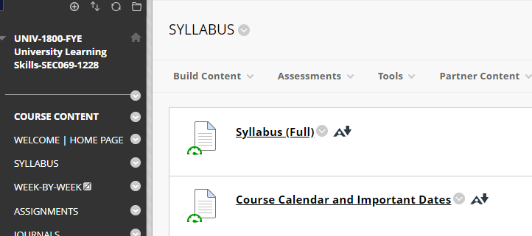
Accessibility Indicators
Provide feedback to instructors about the accessibility of their content all embedded in the context of their course
Ally will check and provide alternative formats for any visual or texbased content including, PDF, Word, and PowerPoint files.

Slide 4
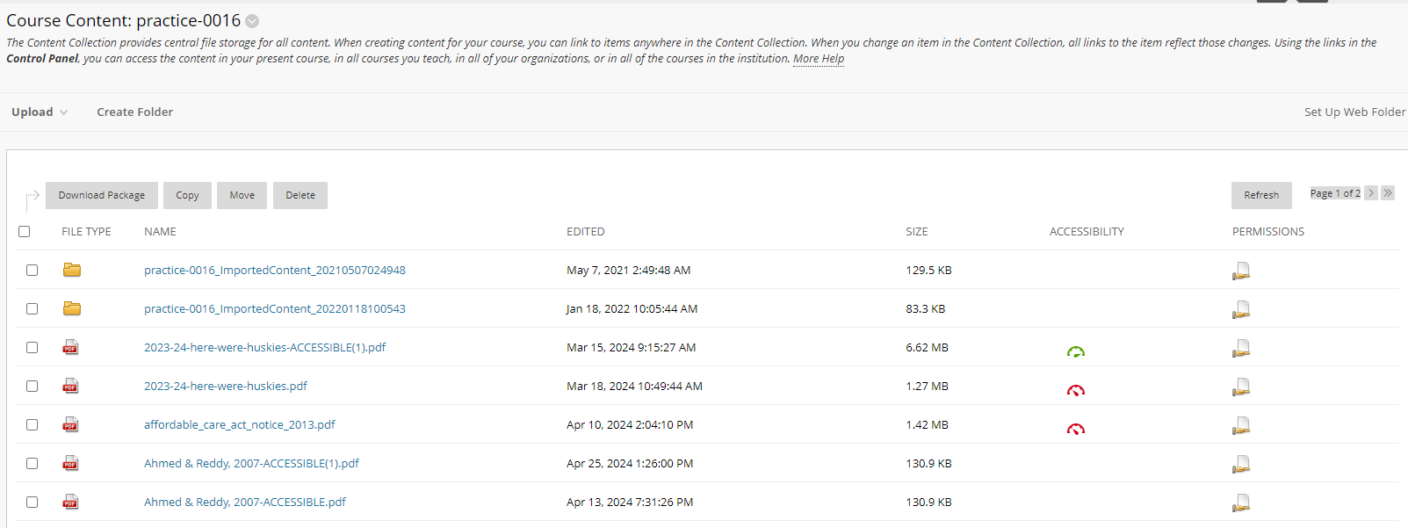
Content Collection: Accessibility Indicators
List of files in a course
Files with Ally scores are linked in course, files without Ally score are not linked in the course.

Slide 5
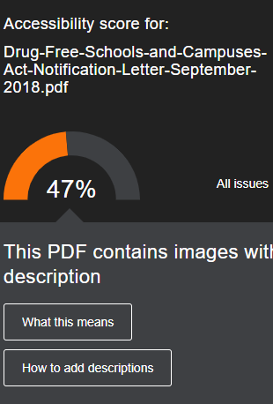
Simple Guidance
Provide guidance on how to fix accessibility issues and generate a change in behavior over time and at the point-of-need.
Step-by-step instructions are offered and when it’s a PDF, it always begin with, “Can you get hold of an original, editable version of this file?”

Slide 6
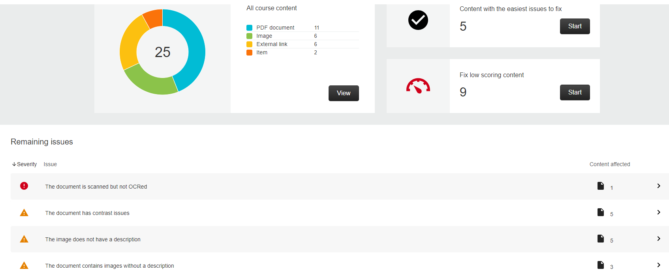
Instructor course report: Accessibility Report Tool
Provide an overall course score and ways to quickly address course files at scale, raising engagement and deepening skills.

Slide 7
Alternative Formats
Advanced machine learning algorithms automatically provides all students access to various formats

Slide 8
Tagged pdf
Structured PDF for improved use with assistive technology.
Only available on Word and PowerPoint files.

Slide 9
html
For viewing in the browser and on mobile devices.

Slide 10
ePub
For reading as an e-book on an iPad and other e-book readers.
Can easily adjust the font size and background color, or highlight the material.

Slide 11
Electronic Braille
BRF version for consumption on electronic braille displays.

Slide 12
Audio
MP3 version for listening on personal devices and in more contexts.
Includes alt-text for images if available.

Slide 13
BeeLine Reader
Enhanced version for easier and faster on-screen reading.
Displays text using a subtle color gradient that helps pull your eye through your readings.

Slide 14
Immersive reader
Aid reading comprehension and grammar skills. Internet required.
Similar to Read & Write

Slide 15
Translated version
A machine translated version of the original document.

Slide 16
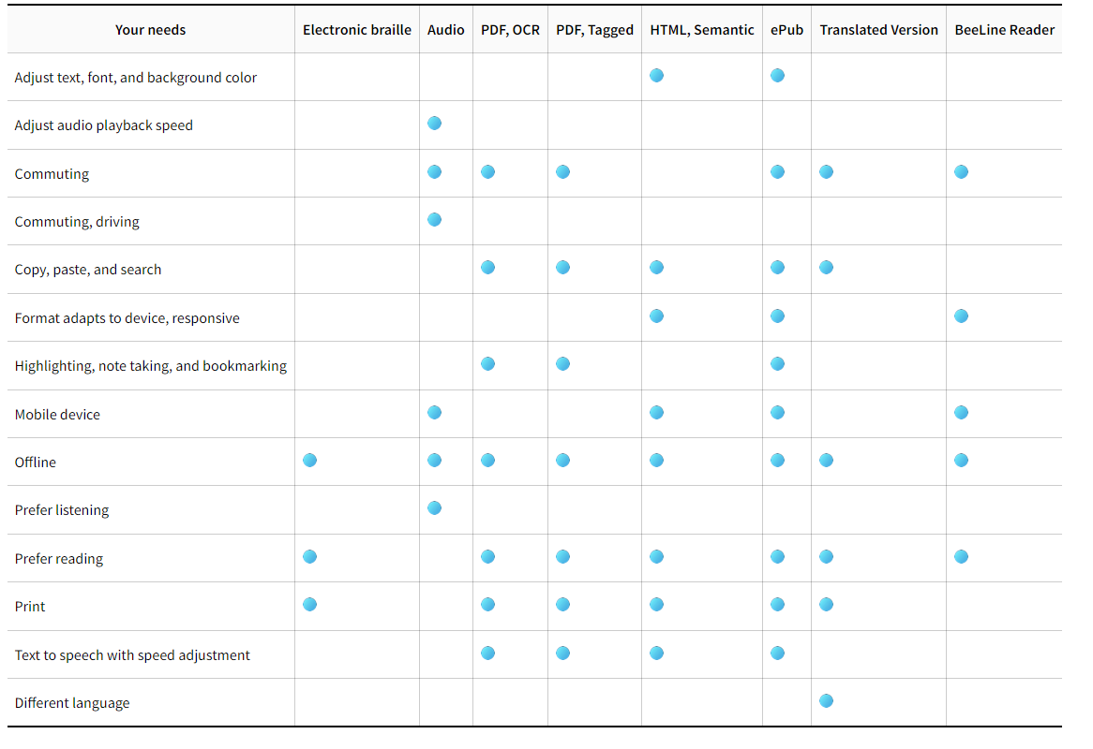
Summary of features

Slide 17
Institutional Report
Provides institution-wide reporting on course content accessibility and drive further improvements at the institution.

Slide 18
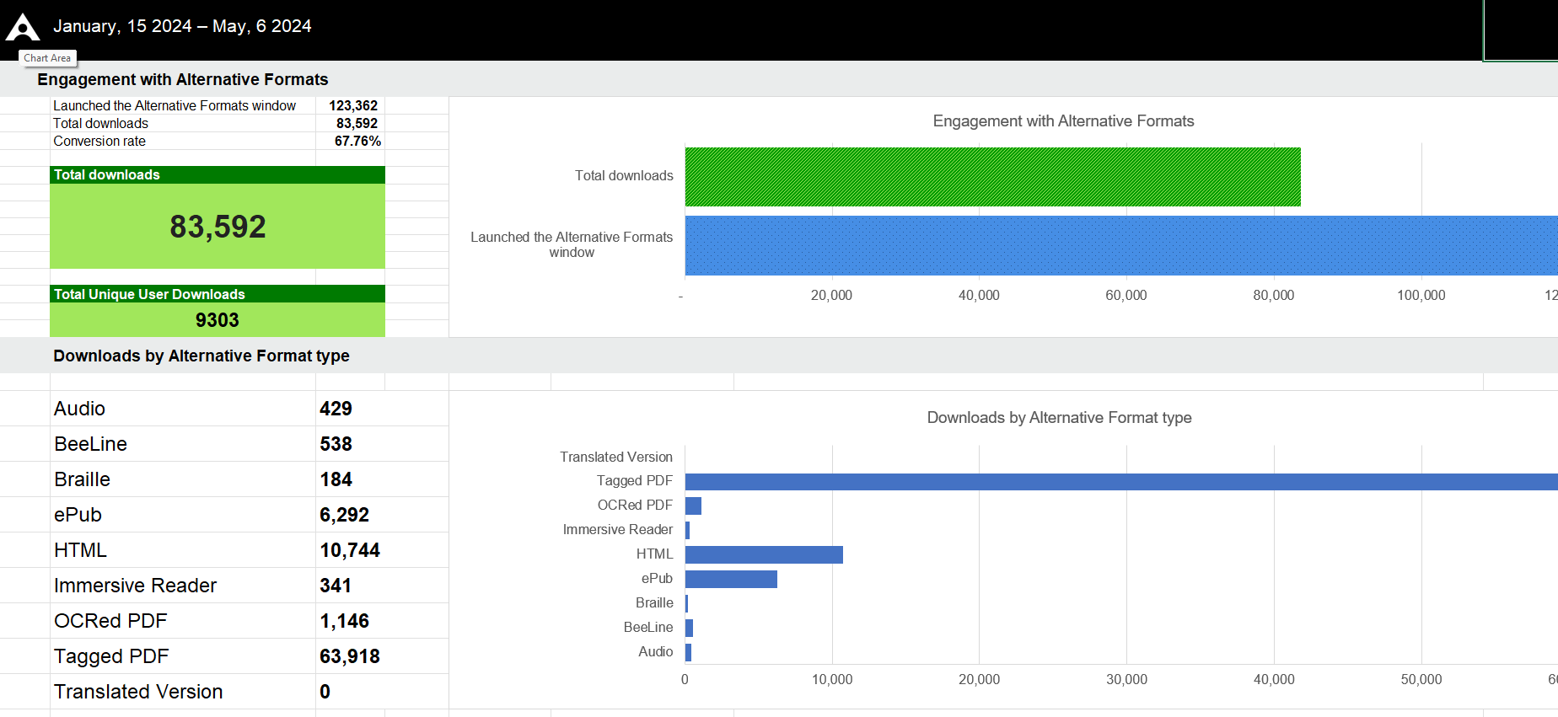
Engagement with alternative formats

Slide 19
Engagement with instructor feedback

