Slide 1

Digital Accessibility
Create an Inclusive and Accessible Experience
Accessible Websites

Slide 2
What Are Examples of Barriers with Websites?

Slide 3
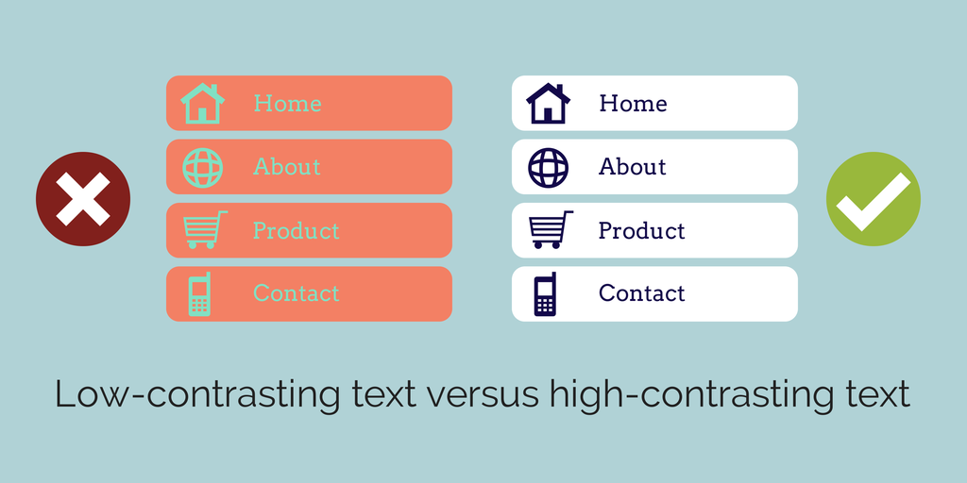
Text with Low Contrast

Slide 4
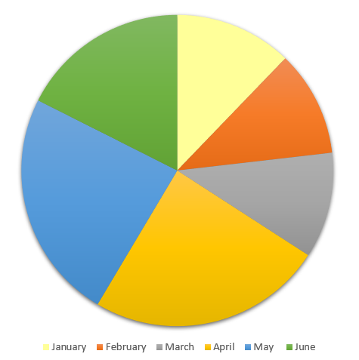
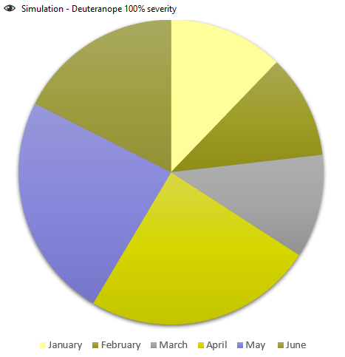
Only Using Color to Convey Information: Red/Green Deficiency

Slide 5
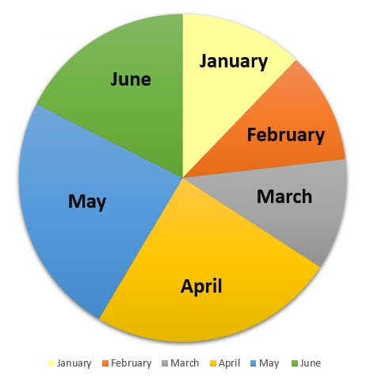
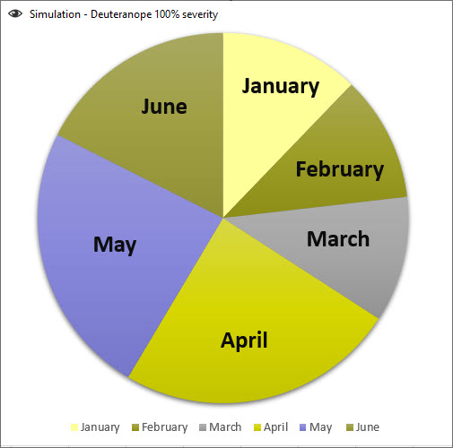
Accessible Pie Chart – Red/Green Deficiency

Slide 6
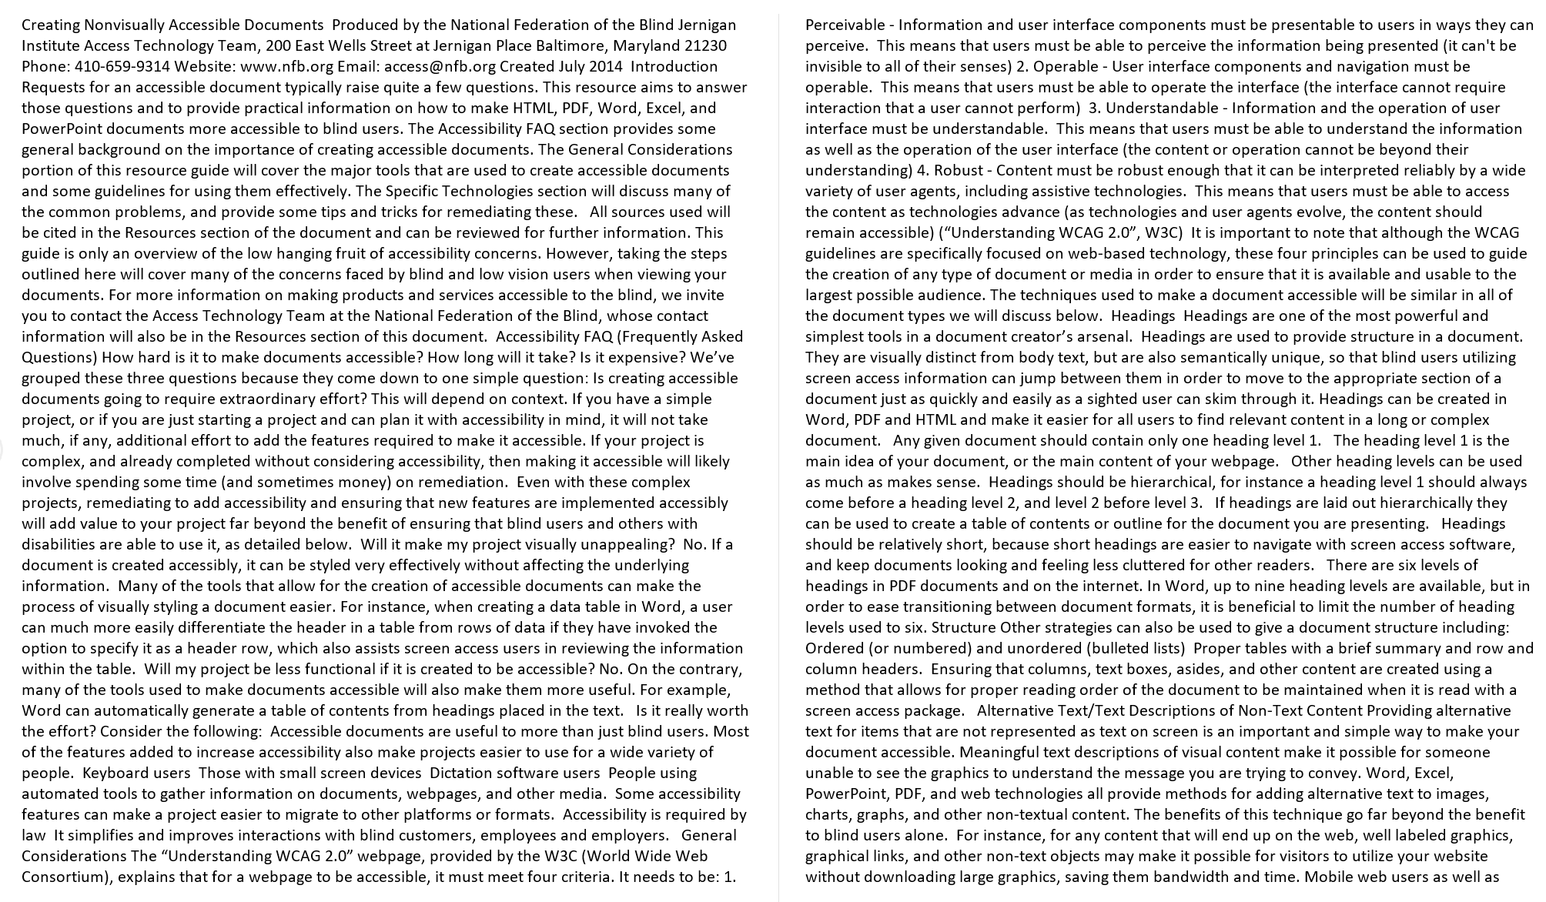
Inaccessible Files

Slide 7
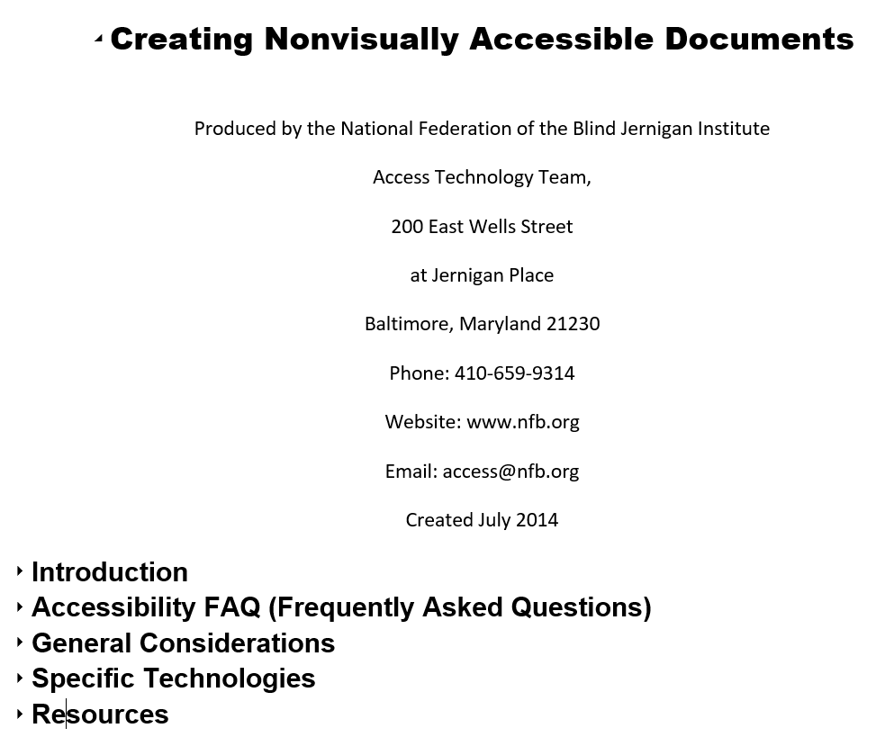
Accessible File
Notes:
Creating Nonvisually Accessible Documents: https://www.nfb.org/blog/creating-nonvisually-accessible-documents
The National Center on Disability and Access to Education (NCDAE) exists to address issues of technology and disability in education policies and practices to enhance the lives of people with disabilities and their families. www.ncdae.org

Slide 8

Inaccessible Links on a Website

Slide 9
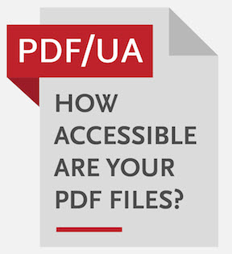

Scanned Document or PDF Created with Online Graphic Design Tool (i.e. Canva)

Slide 10
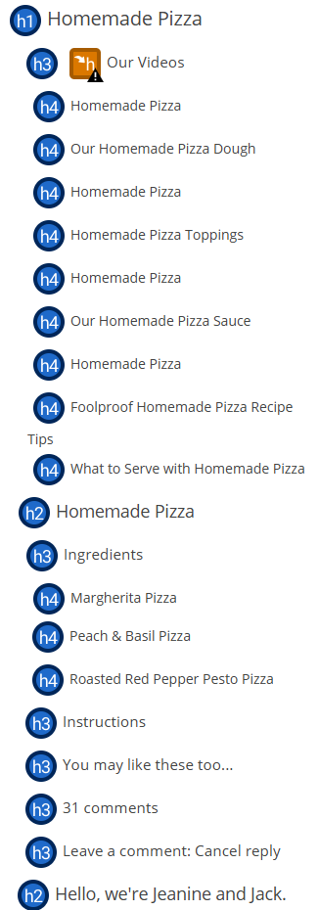
Headers:
Out of Order or Not Meaningful

Slide 11
Accessible Websites
Website & Page Titles are meaningful and descriptive
Use proper Header Structure (H1, H2, H3, etc.)
Alt Text for Images and Tables
Descriptive Hyperlinks
Use True Tables with Headers
Adequate color contrast & don’t use color only for info.
Reading and navigation order is logical
Functionality is available using keyboard only (no traps)
Skip to content available
Captions & transcripts are available for videos
Ensure files are accessible (PDF, Word, PPTx, etc.)
Check accessibility using tools available

Slide 12
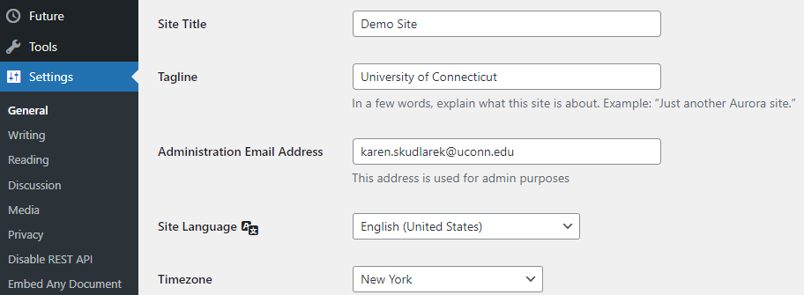
Website: Meaningful Titles
Settings > General (this is Heading 1)

Slide 13
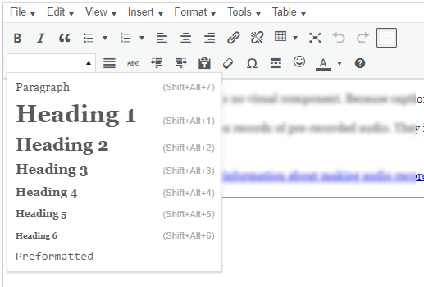
Headings: Website
Use structure when selecting headings (not just font size)
Typically, there is one heading 1 on page, but there may be two if there is a heading one at the top of the page

Slide 14
Alt Text for Images
Do not start alt text with “picture of” or “graphic of”
Alt text is accurate (not file name)
Validate auto-generated alt text
Include enough information for end user
Exclude information found near the image (i.e. caption below image)
Include alt text of images with hyperlink
Alt text can vary for same image based on context
Graphs/Charts and maps are more complex
Ask content creator (person who wants to use the image) to write the alt text

Slide 15
Descriptive Hyperlinks
Screen reader users navigate websites tabbing link to link
Writing link text where it is going
  Do not use “click here,” “learn more,” “read more”
Example:
  IT Accessibility
Don’t underline text that isn’t a link
  Keyboard only users may think it’s a link and can’t access it by tabbing

Slide 16
True Tables
Inaccessible Table
Karen | Jonathan
(860) 486-0506 | (860) 486-1234
karen.skudlarek@uconn.edu | jonathan.husky@uconn.edu
Accessible Table
Name | Phone Number | Email
Karen | (860) 486-0506 | karen.skudlarek@uconn.edu
Jonathan | (860) 486-1234 | jonathan.husky@uconn.edu

Slide 17
Accessible Colors
Contrast Font 18 and higher 3:1
Contrast Font below 18 4.5:1
Do not use color alone to convey information
Avoid using Red and Black or Red and Green Combination
Text on Images
Use tools to check color contrast and simulate color blindness

Slide 18
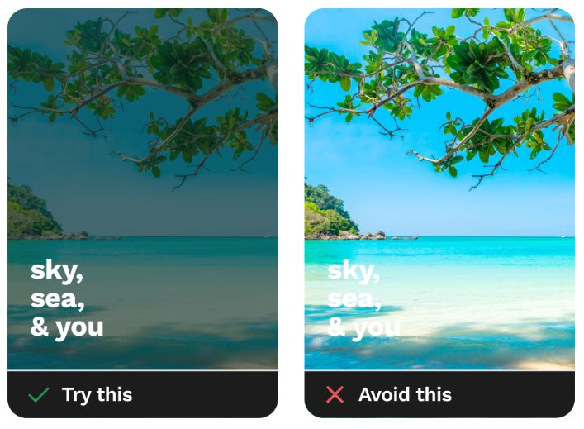
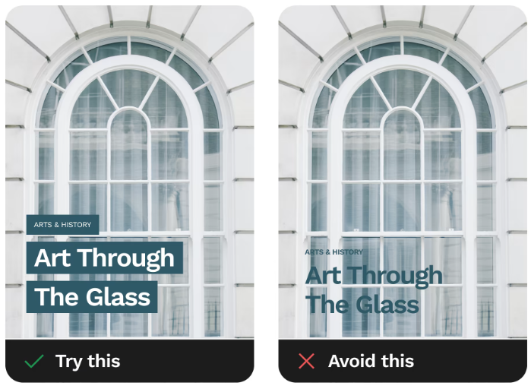
Text on Images: Dos and Don’ts
Source: https://www.smashingmagazine.com/2023/08/designing-accessible-text-over-images-part1/

Slide 19
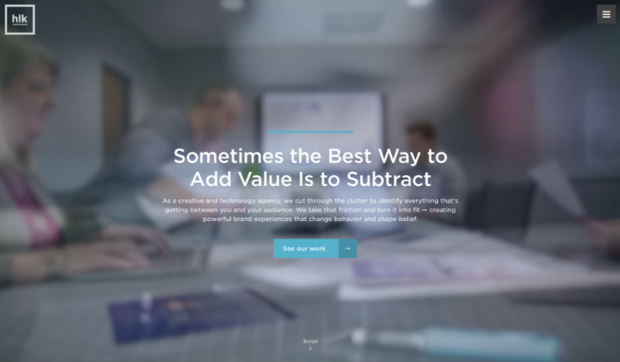
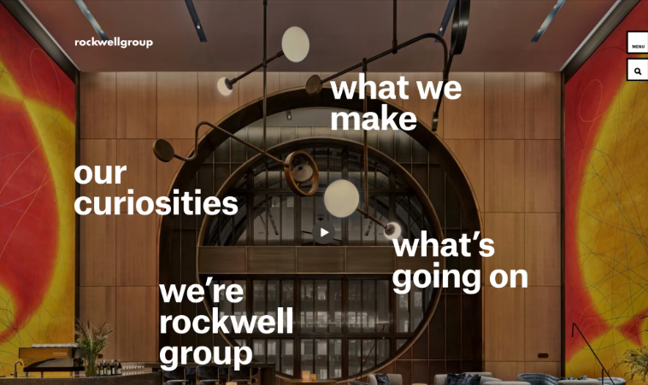
Text on Images that Work
Source: https://www.smashingmagazine.com/2023/08/designing-accessible-text-over-images-part1/

Slide 20
Reading Order and Keyboard Navigation
Screen reader users navigate websites using keyboard only
  Ensure reading order and navigation is logical
  Ensure functionality using keyboard only (no traps)
  Skip to Content, Skip to Search, etc. is available
Screen reader users can navigate websites by tabbing link to link
  Ensure links are meaningful

Slide 21
Include Captions and Transcripts for Videos
Ensure videos are shared from a video platform such as Kaltura or YouTube
  If not, then captions must be burned into the video (open captions)
Edit and validate any auto generated captions
A workshop for editing captions in Kaltura and YouTube will be available

Slide 22
Basic Accessibility Checklist for Websites
  Website & Page Titles are meaningful and descriptive
  Use Properly Structured Heading (H1, H2, H3, etc.)
  Alt Text for Images and Tables
  Descriptive Hyperlinks
  Use True Tables with Headers
  Adequate color contrast & don’t use color only to convey info
  Reading and navigation order is logical
  Functionality is available using keyboard only (no traps)
  Skip to content available
  Captions & transcripts are available for videos
  Ensure files are accessible (PDF, Word, PPTx, etc.)
  Check accessibility using tools available (WAVE, Sally Bb Ally)

Slide 23
Tools to Check for Accessibility

Slide 24
Tools to Check Websites
WAVE by WebAIM
  Browser Extension
  Displays code for webpage
Sa11y
  Bookmarklet
  Has Color Filter to simulate color blindness
Blackboard Ally
  Scans weekly and offers a score for the site
  Also found in HuskyCT Courses and Organizations
  A separate training will be offered for this tool

Slide 25




Screen Readers
NVDA
  Free
  Windows Only
Mac: VoiceOver
JAWS
  For purchase
  Most popular screen reader
Windows: Narrator
Note: A separate training will be available to demonstrate using screen readers for testing

Slide 26
Tool to Check PDFs
PDF Accessibility Checker: PAC 2021
  Free
  Windows only
Acrobat Pro
  Doesn’t check reading order or color contrast
  Only knows what it knows
  Has OCR
  Very technical

Slide 27
Upcoming Trainings
Check IT Accessibility Website for more trainings

