Slide 1
Digital Accessibility Create an Inclusive and Accessible Experience
Accessible PowerPoint Presentations

Slide 2
Quick Statistics (ages 21-64) Individuals with Disability vs. Individuals without Disability 2018 (2022)
Bachelor’s Degree or more without disability: 35.2% (38.6%)
Bachelor’s Degree or more with disability: 15.2 % (18.7%)
Employment without disability: 80.0% (63%)
Employment with disability: 37.8 % (30%)
Source: https://www.disabilitystatistics.org/StatusReports/2018-PDF/2018-StatusReport_US.pdf
Notes:
Erickson, W., Lee, C., & von Schrader, S. (2020). 2018 Disability Status Report: United States. Ithaca, NY: Cornell University Yang-Tan Institute on Employment and Disability(YTI).
https://www.disabilitystatistics.org/StatusReports/2018-PDF/2018-StatusReport_US.pdf
2022: Employment with disability 30%, Employment without disability 63%

Slide 3
Accessible PowerPoint Presentations
Document Title
Accessible Fonts
Alt Text
Descriptive Hyperlinks
True Tables
Adequate Color Contrast
Give every slide a unique title (H1)
Ensure the reading order is accurate
Avoid animations & automatic slide transitions
Captions for Live Presentations
Captions for Embedded Video/Audio
Accessibility Checkers

Slide 4
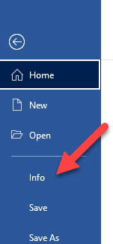
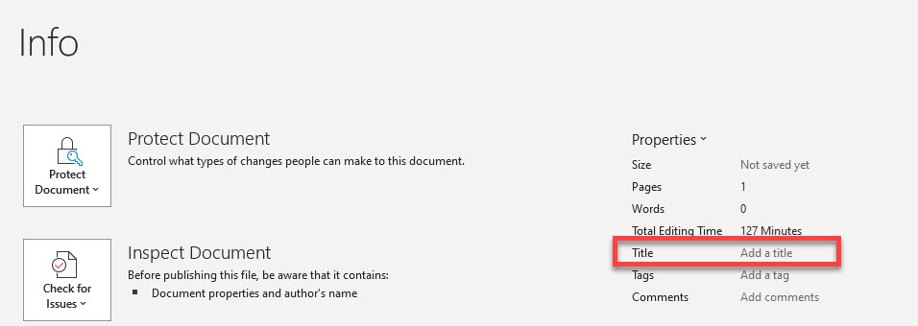
Add Meaningful Title & Author to Document

Slide 5
Accessible Fonts (sans serif)
Good choices are:
Arial
Calibri
Verdana
Try to use font size 12 or higher
Use Strong style for bold and Emphasis style for Italics

Slide 6
Alt Text
Do not start alt text with “picture of” or “graphic of”
Alt text is accurate (not file name)
Validate auto-generated alt text
Include enough information for end user
Exclude information found near the image (i.e. caption below image)
Include alt text of images with hyperlink
Alt text can vary for same image based on context
Graphs/Charts and maps are more complex
Ask content creator (person who wants to use the image) to write the alt text

Slide 7
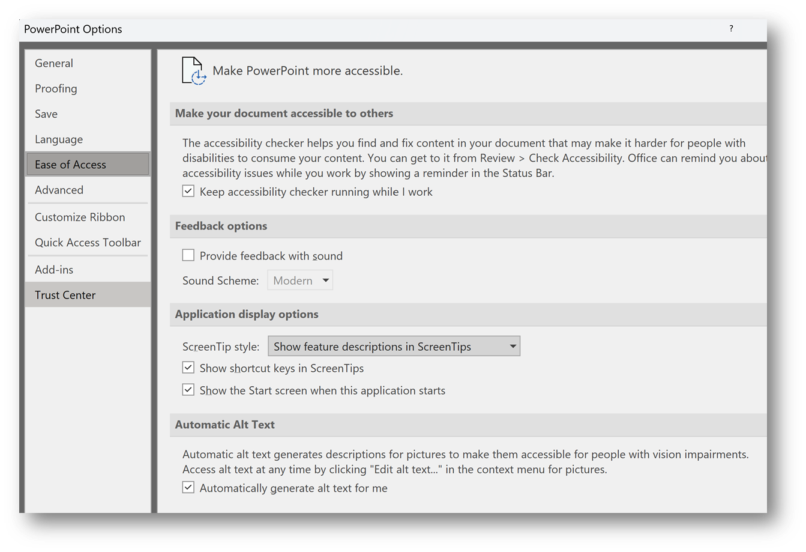
Automatic Alt Text Setting in Microsoft
You can turn on/off the Automatic Alt Text Setting found in File > Options > Ease of Access > Automatic Alt Text

Slide 8
Descriptive Hyperlinks
Screen reader users navigate websites tabbing link to link
Writing link text where it is going
Do not use “click here,” “learn more,” “read more”
Example:
IT Accessibility
Don’t underline text that isn’t a link
Keyboard only users may think it’s a link and can’t access it by tabbing

Slide 9
True Tables
Use only data for tables
Designate top row as the header for each column
Be sure to turn on Repeat Header Row
Add Alt Text to the Table
Cannot create accessible table if using split cells, merged cells, or nested tables in Word. Must use Acrobat Pro.
Tab through each cell to check for navigation (left to right and down)

Slide 10
True Tables Examples
Inaccessible Table
Karen | Jonathan
(860) 486-0506 | (860) 486-1234
karen.skudlarek@uconn.edu | jonathan.husky@uconn.edu
Accessible Table
Name | Phone Number | Email
Karen | (860) 486-0506 | karen.skudlarek@uconn.edu
Jonathan | (860) 486-1234 | jonathan.husky@uconn.edu

Slide 11
Accessible Colors
Contrast Font 18 and higher 3:1
Contrast Font below 18 4.5:1
Do not use color alone to convey information
Avoid using Red and Black or Red and Green Combination
Text on Images
Use tools to check color contrast and simulate color blindness

Slide 12
Slide Title
Make each slide title unique
Title will be presented as a heading to screen reader users and will be the first thing read on each slide.

Slide 13
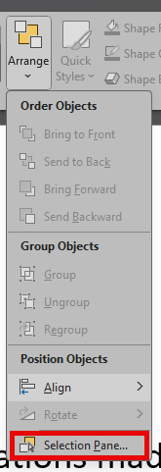
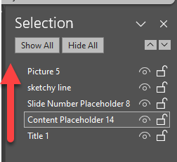
Slide Reading Order
By default, screen reader will read:
slide title first
followed by other content defined by slide layout
then any added content
If content is added, be sure the reading order is correct
To check reading order either
Home > Arrange > Selection Pane (this is reversed order) example shown on this slide
Review > Check Accessibility > Reading Order Pane (example on next slide)

Slide 14
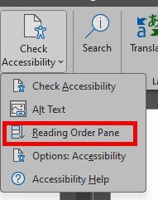
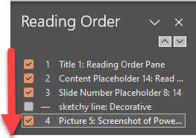
Reading Order Pane
Read in order listed
Uncheck decorative elements
If you have complex diagrams or illustrations made of many objects, group the objects into logical units.
Screen-reader user can read the grouped units rather than all of the individual objects in them.
Learn more about Reading Order Pane on Microsoft’s website

Slide 15
Live Presentation: Captions
LIVE PRESENT
LIVE CAPTIONS
End User chooses to turn on/off
Save file to OneDrive
Slide Show > Present Live drop-down arrow and set Audience Settings
Present > Present Live
Language can be changed by end user
Everyone sees the captions
Use desktop version of PowerPoint
Slide Show > Always Use Subtitles

Slide 16
Embedded Video Captions
Must use VTT captions.
Kaltura creates SRT captions
Edit video > Captions > Download icon
Use Happy Scribe to convert captions
Click video, Playback > Insert captions

Slide 17
Basic Accessibility Checklist for PowerPoint
Document Title
Accessible Font (Arial, Calibri, Verdana)
Alt Text for images (verify auto generated alt text)
Descriptive Hyperlinks
True Tables
Adequate color contrast
Give every slide a unique title (H1)
Ensure the read order is accurate
Avoid animations & automatic slide transitions
Captions for Live Presentations or Embedded Video/Audio
Accessibility Checkers

Slide 18
Accessibility Checkers
Microsoft Office
Review > Check Accessibility
Turn on Navigation Pane
HuskyCT/Blackboard Ally
For courses and websites
PDF/UA PDF Checker
It’s more technical than using Office or Ally Accessibility checkers but can give you a sense of what may need to be remediated for the PDF.

Slide 19
Scanning to PDF from Copiers
Be sure to OCR the document before scanning to PDF.
Selecting OCR (Optical Character Recognition) for PDFs created at UConn printers converts typed or printed text into machine-encode text to be read by a screen reader and searched.

Slide 20
More UConn Resources
ITS Accessibility @ UConn
eCampus Accessible Syllabus Templates
Office of Institutional Equity: Accessibility @ UConn
Center for Students with Disabilities

