Slide 1
Digital Accessibility Create an Inclusive and Accessible Experience
Accessible Word Documents

Slide 2
Quick Statistics (ages 21-64) Individuals with Disability vs. Individuals without Disability 2018 (2022)
Bachelor’s Degree or more without disability: 35.2% (38.6%)
Bachelor’s Degree or more with disability: 15.2 % (18.7%)
Employment without disability: 80.0% (63%)
Employment with disability: 37.8 % (30%)
Source: https://www.disabilitystatistics.org/StatusReports/2018-PDF/2018-StatusReport_US.pdf
Notes:
Erickson, W., Lee, C., & von Schrader, S. (2020). 2018 Disability Status Report: United States. Ithaca, NY: Cornell University Yang-Tan Institute on Employment and Disability(YTI).
https://www.disabilitystatistics.org/StatusReports/2018-PDF/2018-StatusReport_US.pdf
2022: Employment with disability 30%, Employment without disability 63%

Slide 3
Accessible Word Documents
Document Title & Author
Accessible Fonts (sans serif)
Arial, Calibri, and Verdana
Headers and Styles
Alt Text
Descriptive Hyperlinks
True Tables
Adequate Color Contrast
Avoid Justified (Centered) Formatting
Accessibility Checkers
Creating PDFs from Copiers

Slide 4
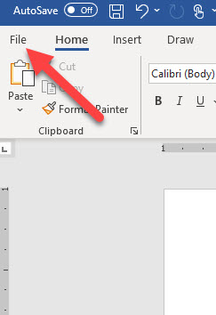
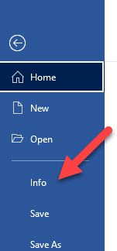
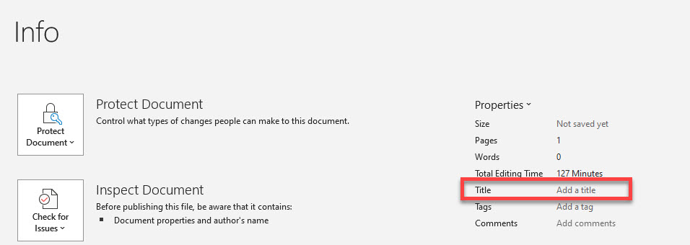
Add Meaningful Title & Author to Document

Slide 5
Accessible Fonts (sans serif)
Good choices are:
Arial
Calibri
Verdana
Try to use font size 12 or higher
Use Strong style for bold and Emphasis style for Italics

Slide 6
Headers and Styles
Tip: Turn on Navigation Pane in Word to see the structure. Click on View in the Ribbon and turn it on under Show section

Slide 7
Headings: Word
Use the Styles found in the Home tab of the Ribbon
You can modify the heading format by right mouse clicking on the Heading in the Styles panel
Emphasis Style is for italics and Strong is for bold

Slide 8
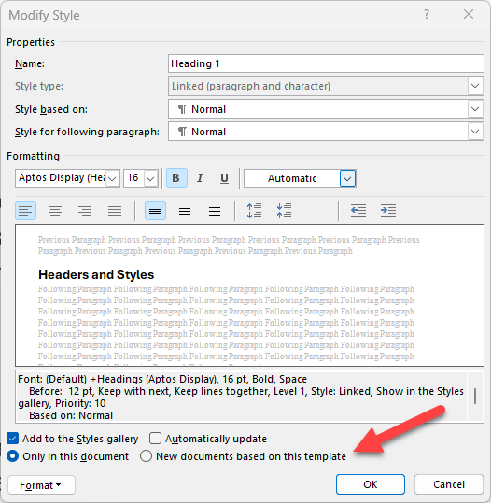
Blank Template for Word: Normal.dotm
When you open Word and use the Blank template, it uses the Normal.dotm file.
If you make changes to any of the Styles in the Blank template and select New documents base on this template, it will save the changes to the Normal.dotm.
You can create custom templates if you use different Heading Styles for various documents.

Slide 9
Alt Text
Do not start alt text with “picture of” or “graphic of”
Alt text is accurate (not file name)
Validate auto-generated alt text
Include enough information for end user
Exclude information found near the image (i.e. caption below image)
Include alt text of images with hyperlink
Alt text can vary for same image based on context
Graphs/Charts and maps are more complex
Ask content creator (person who wants to use the image) to write the alt text

Slide 10
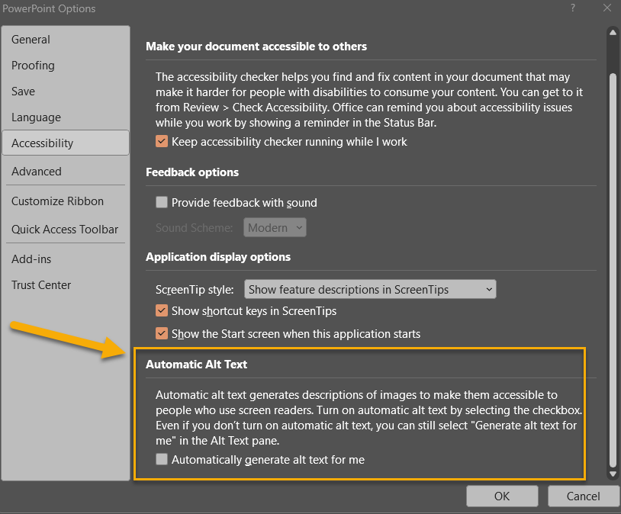
Automatic Alt Text Setting in Microsoft
You can turn on/off the Automatic Alt Text Setting found in File > Options > Accessibility

Slide 11
Descriptive Hyperlinks
Screen reader users navigate websites tabbing link to link
Writing link text where it is going
Do not use “click here,” “learn more,” “read more”
Example:
IT Accessibility
Don’t underline text that isn’t a link
Keyboard only users may think it’s a link and can’t access it by tabbing

Slide 12
True Tables
Use only data for tables
Designate top row as the header for each column
Be sure to turn on Repeat Header Row
Add Alt Text to the Table
Cannot create accessible table if using split cells, merged cells, or nested tables in Word. Must use Acrobat Pro.
Tab through each cell to check for navigation (left to right and down)

Slide 13
True Tables Examples
Inaccessible Table
Karen | Jonathan
(860) 486-0506 | (860) 486-1234
karen.skudlarek@uconn.edu | jonathan.husky@uconn.edu
Accessible Table
Name | Phone Number | Email
Karen | (860) 486-0506 | karen.skudlarek@uconn.edu
Jonathan | (860) 486-1234 | jonathan.husky@uconn.edu

Slide 14
Accessible Colors
Contrast Font 18 and higher 3:1
Contrast Font below 18 4.5:1
Do not use color alone to convey information
Avoid using Red and Black or Red and Green Combination
Text on Images
Use tools to check color contrast and simulate color blindness

Slide 15
Avoid Justified (Centered) Formatting
Although it allows the text to appear as a single block with perfect margins, it also creates inconsistent spacing, which can force the reader’s eyes to “jump" when reading.
This becomes a serious issue when using assistive technologies (AT). Many people with vision disabilities use screen magnifiers or enlarge web content by “zooming in" on the page. If text is justified, these users may see large, empty spaces between (or within) words — or the words may run together in a confusing mess of characters.
Fully justified text can create uneven spaces between words and letters, making it difficult for those with dyslexia.

Slide 16
Accessibility Checkers
Microsoft Office
Review > Check Accessibility
Turn on Navigation Pane
HuskyCT/Blackboard Ally
For courses and websites
PDF/UA PDF Checker
It’s more technical than using Office or Ally Accessibility checkers but can give you a sense of what may need to be remediated for the PDF.

Slide 17
Scanning to PDF from Copiers
Be sure to OCR the document before scanning to PDF.
Selecting OCR (Optical Character Recognition) for PDFs created at UConn printers converts typed or printed text into machine-encode text to be read by a screen reader and searched.

Slide 18
More UConn Resources
ITS Accessibility @ UConn
eCampus Accessible Syllabus Templates
Office of Institutional Equity: Accessibility @ UConn
Center for Students with Disabilities

Slide 19
Basic Accessibility Checklist for Word Documents
Document Title & Author
Accessible Font (Arial, Calibri, Verdana)
Turn on Navigation Pane)
Alt Text for images and Tables
Headers and other Styles
Descriptive Hyperlinks
Using True Tables with Headers (repeat header row)
Adequate color contrast
Check accessibility with Office and/or Blackboard Ally

